Slide 1
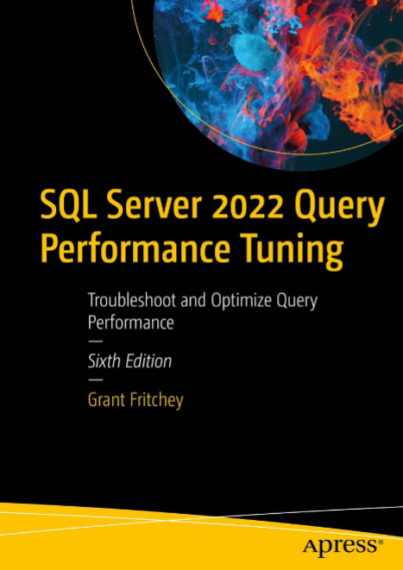
SQL Server Performance Study Group
Engineering focused
Understand how SQL works internally
Learn how to use SQL well
Join a group to challenge, grow, and support each other in improving our SQL Server Performance Skills
Friday, September 8th @ 12:30PM EST
Open Discussion Kickoff

Slide 2

Agenda
Study Group Structure
Setup
Source Material
Proposed Topics
Action items
Questions

Slide 3

Study Group Structure
1 hour meeting every Friday, 12:30PM - 1:30PM EST
Presenting weekly topic (25 mins)
Share take away homework (10 mins)
Lean Coffee (25 mins)
All are welcome to attend, share, and learn
Focus will be on improving our knowledge & skills so that we use MS SQL Server more effectively

Slide 4
Setup
Install MS SQL Server locally
SQL 2022 Developer
https://www.microsoft.com/en-us/sql-server/sql-server-downloads
Install AdventureWorks2022 OLTP
https://learn.microsoft.com/en-us/sql/samples/adventureworks-install-configure?view=sql-server-ver16&tabs=ssms

Slide 5
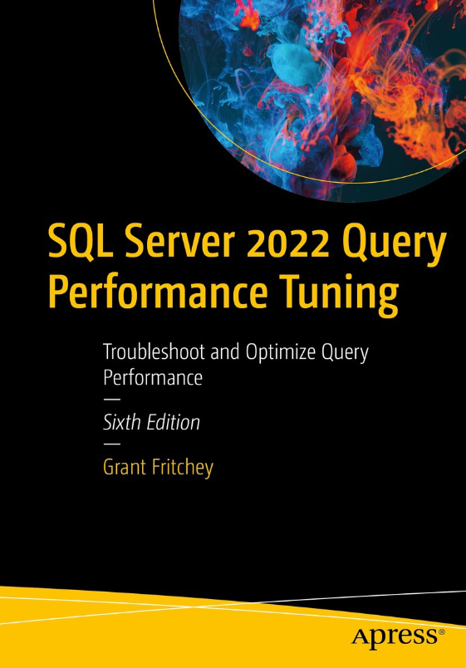
Primary Source

Slide 6

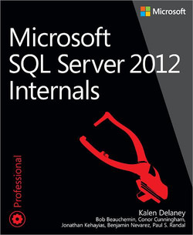

Other Sources

Slide 7


Other Sources
https://learn.microsoft.com/en-us/sql/sql-server/

Slide 8
Proposed Topics
Fundamentals
The Data Scaling Problem
RDBMS
B-TREE
ACID
Locking, Blocking, and Deadlocking
KISS your Data
Data Consistency
Proposed topics for next week

Slide 9
Proposed Topics
SQL Internals & Optimization
Measuring Performance
Execution Plans
Query Store
Plan Caching
Stored Procedures
Pages, Extents, Data Rows, and Data Types
Table Design
Index Design
GUIDs
Statistics
Parameter-Sensitive Queries
Indexed Views
Deadlocks

Slide 10
Proposed Topics
TSQL Topics
Casting
SET NOCOUNT ON
Table Variables, Temp Tables, CTE
Top & Order By
Cross Apply
Wasteful Compute
Controlling Locking
Query Hints

Slide 11
Proposed Topics
Other Topics
Troubleshooting Performance
Managing DB as code (i.e. Liquibase)
Aggregates
Additive Change (application of OCP)

Slide 12
Action Items
Install MS SQL Server Locally
Install AdventureWorks2022 DB OLTP
Share what you learn and apply within your product areas.

Slide 13

Questions?

